Slide 1


Emergency Medical Services in King County
“The 9-1-1 system”
Notes:
Points for Copass:
History of how Medic One came together
If system could respond well to cardiac arrest, it could respond well to any call
PMs are trained as doctors in the field
Follow up on Copass’ talk about the history of Medic One:
Partnership (regionalization)
Standardization (regionalization/ medical model)
Tiered
Paramedic training/medical model (m)
QI (ongoing oversight/efficiencies)
Levy funded

Slide 2
Objectives: Be able to:
describe situations in which people should call 911 (or a non-emergency number)
explain 911 dispatch protocols
explain when and how to connect to interpreter services during 911 call

Slide 3
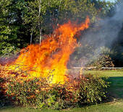
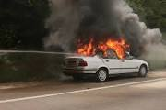
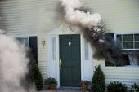

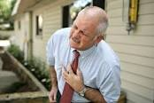
Emergency or not?
Call 9-1-1 for…
Serious medical emergencies: includes chest pains, seizures, and bleeding
Fires: structure, vehicle, brush, and so on.

Slide 4
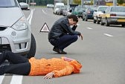
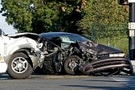
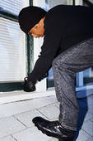

Emergency or not?
Call 9-1-1 for…
Crimes in-progress: including a robbery, burglary, prowler, or fights.
Other life threatening situations:
such as traffic accident with injuries

Slide 5
Call other agencies for…
Power outages: contact your utility company to report an outage.
Traffic information: Call 5-1-1
Social services: Call 2-1-1

Slide 6
Call 2-1-1 if you are in need of information on:
Shelters
Food assistance
Health care (clinics, not emergency)
Financial information/education
Employment
Legal assistance
Mental Health
Substance Abuse

Slide 7
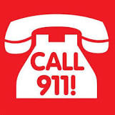
If unsure

Slide 8
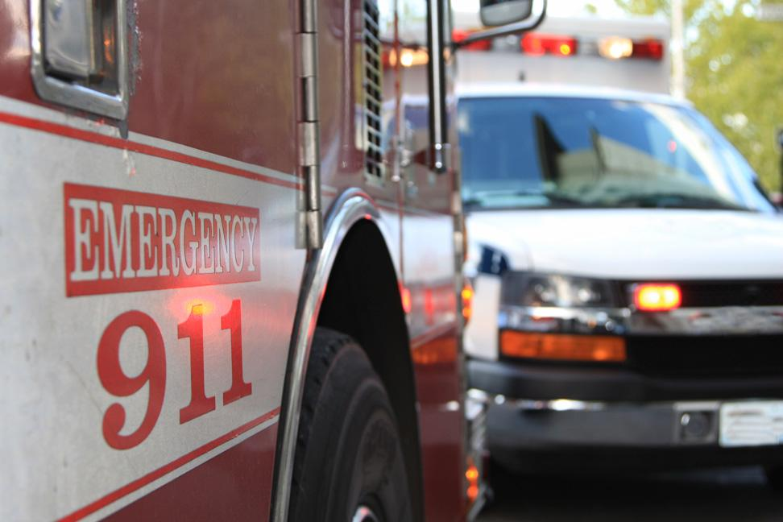
What happens when you dial 9-1-1?

Slide 9
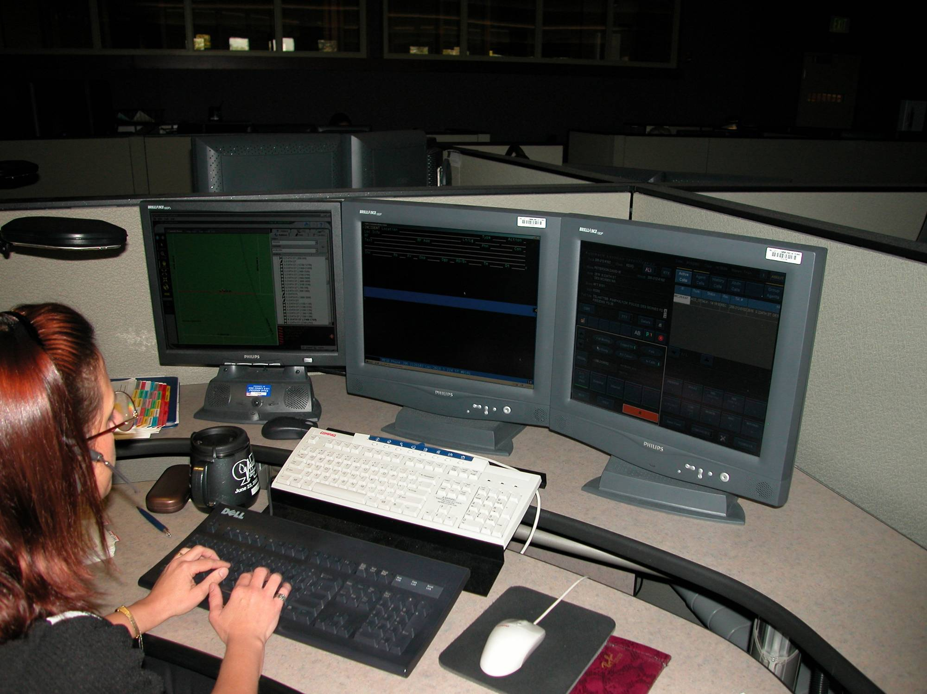

“9-1-1, what is your emergency?”
Photo courtesy of Valley Communications Center

Slide 10

9-1-1 dispatch protocol
911, what is your emergency?”
“What’s the address?” (phone)
“Is patient conscious?”
“Is patient breathing normally?”
“What’s your name? patient’s age?”

Slide 11
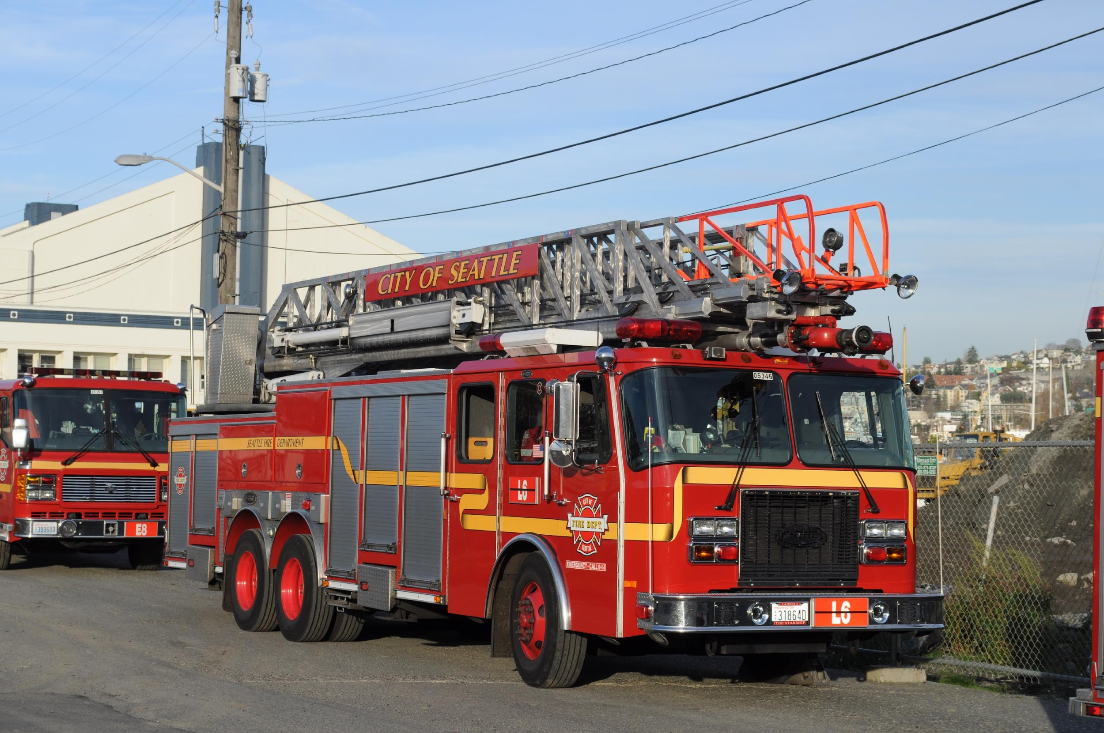
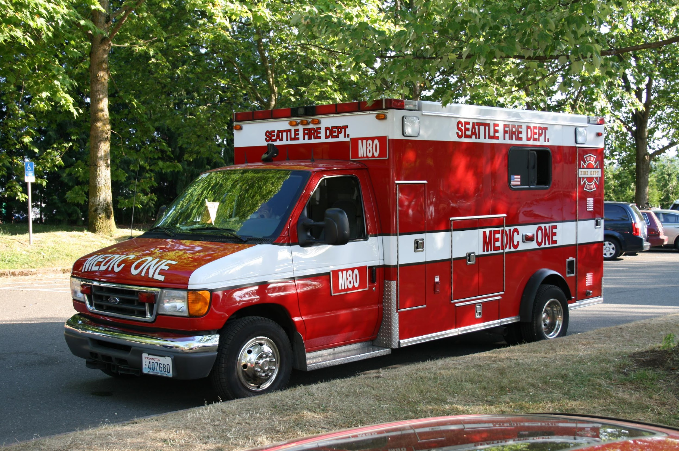
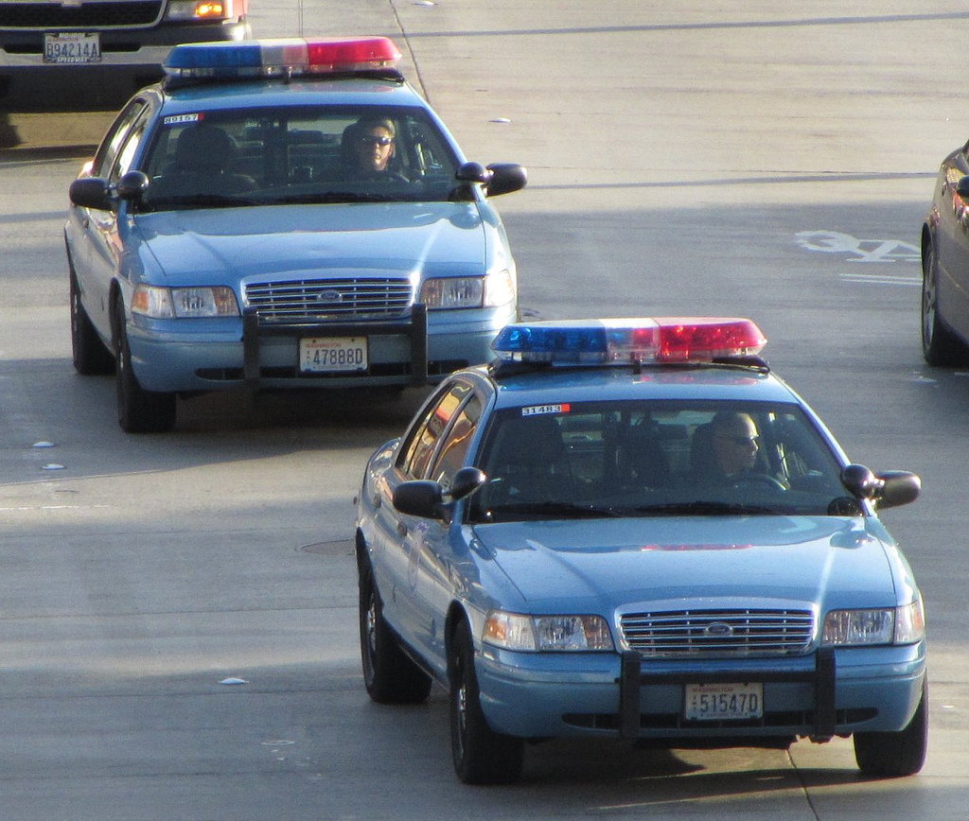
First responders
Emergency
Medical Technicians
(EMT)
Firefighters
Police

Slide 12
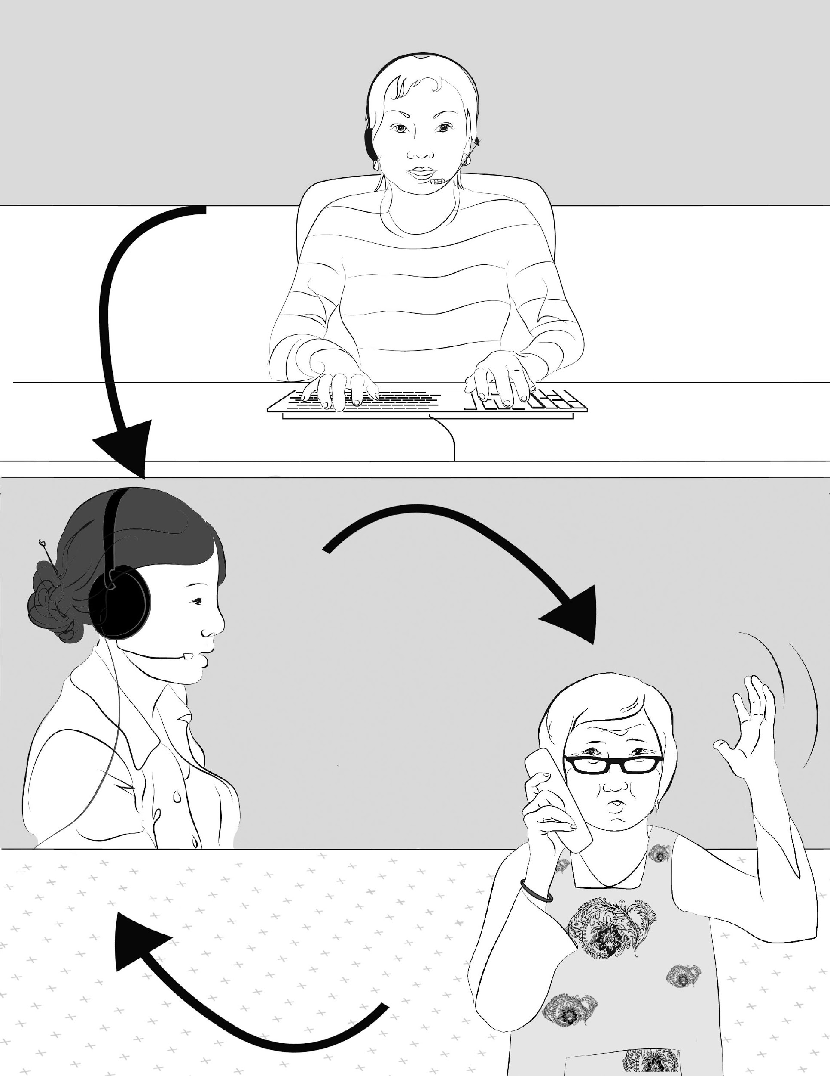
911 phone interpretation services
Say your address in English if you can
Ask for an interpreter if you want one
Say your language in English
Stay on the line while you wait for the interpreter
“A 3-way phone call”
Notes:
Focus group at CISC August 2012 Chinese information and Service Center

Slide 13
911 phone interpretation services
Answer the questions from the interpreter promptly
Don't try to answer the questions from the dispatcher directly but wait for the interpreter to translate it to you.
Stay on the line until you are told it is okay to hang up
Notes:
Focus group at CISC August 2012 Chinese information and Service Center

Slide 14
COMPRESSION-ONLY CPR EDUCATION
For adults

Slide 15
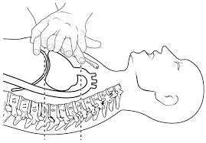
Cardio-pulmonary resuscitation (CPR)
An emergency procedure in which the heart and lungs are made to work by compressing the chest, forcing air into the lungs

Slide 16

Importance of CPR
Cardiac Arrest = when the heart stops beating normally = Patient collapses
Patient needs CPR right away: minutes count!

Slide 17
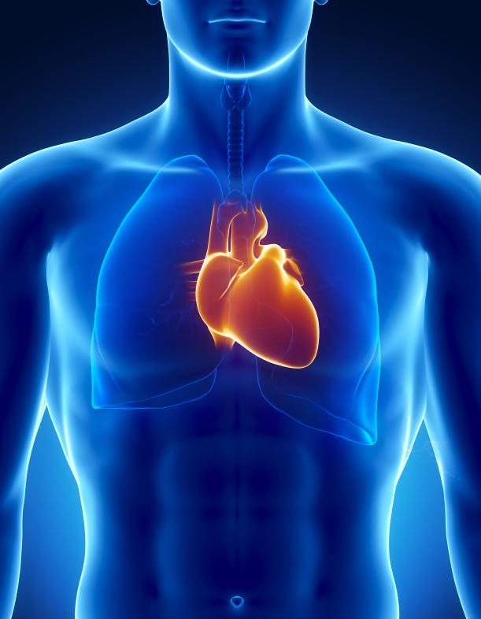
Bystander CPR:
Doubles survival
No need to be formally trained or certified in CPR
Dispatchers offer “just in time” instructions

Slide 18
Steps to Bystander CPR
Check to make sure the scene is safe
Check if patient can respond to you
Call 911
Kneel by side of patient
Put one hand in middle of the chest right between the nipples and put the other hand on top of that hand
With arms locked, push down hard and fast
Stay on the line; keep pushing until help arrives

Slide 19

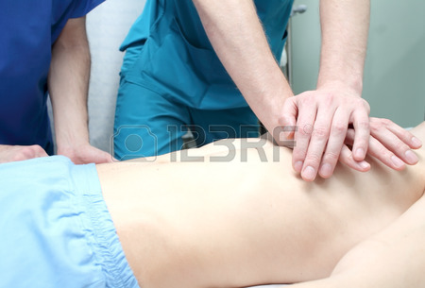
Put one hand on middle of chest and put the other hand on top of that hand

Slide 20
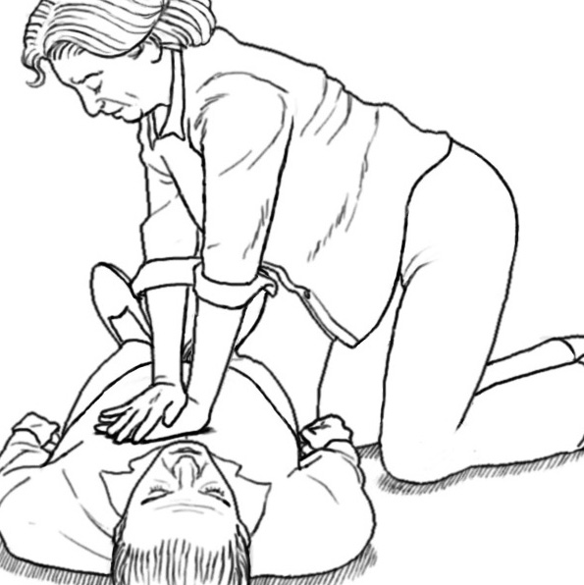
Push Hard and Fast
100 beats per minute

Slide 21
DON’T STOP UNTIL HELP ARRIVES

Slide 22
Emergency Medical Services in King County
Questions?
Notes:
Points for Copass:
History of how Medic One came together
If system could respond well to cardiac arrest, it could respond well to any call
PMs are trained as doctors in the field
Follow up on Copass’ talk about the history of Medic One:
Partnership (regionalization)
Standardization (regionalization/ medical model)
Tiered
Paramedic training/medical model (m)
QI (ongoing oversight/efficiencies)
Levy funded

